Slide 1
High Performance Python Lab Term 2 2020/2021
Lecture 5. Message Passing Interface (mpi4py) continued, new tasks, crashcourse on using supercomputer

Slide 2
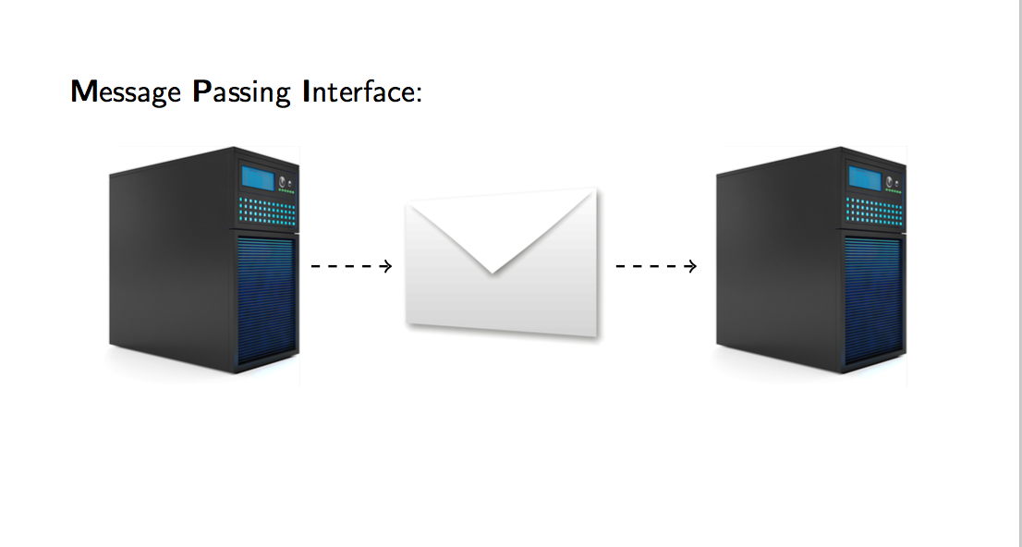
MPI
http://mpitutorial.com/

Slide 3

MPI

Slide 4

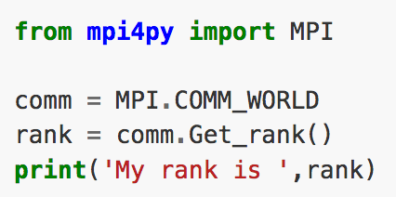
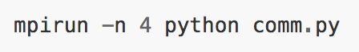
MPI for python

Slide 5
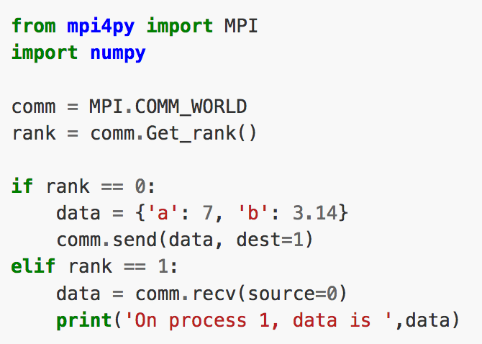
MPI. Point-to-point communication
Important:
BLOCKING COMMUNICATION

Slide 6
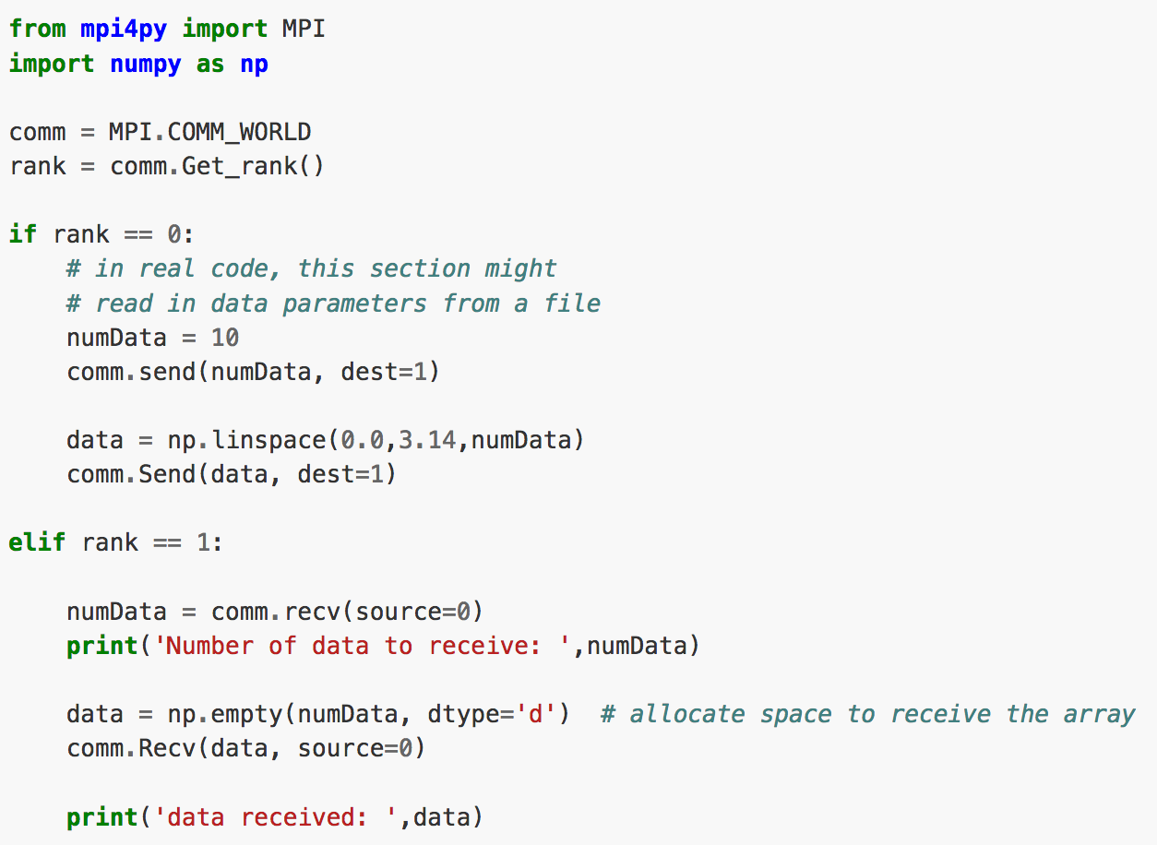
MPI. Point-to-point communication

Slide 7
MPI. Point-to-point communication

Slide 8
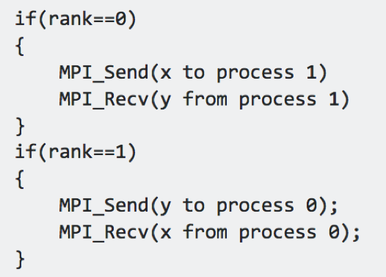
MPI_Send / MPI_Recv example

Slide 9
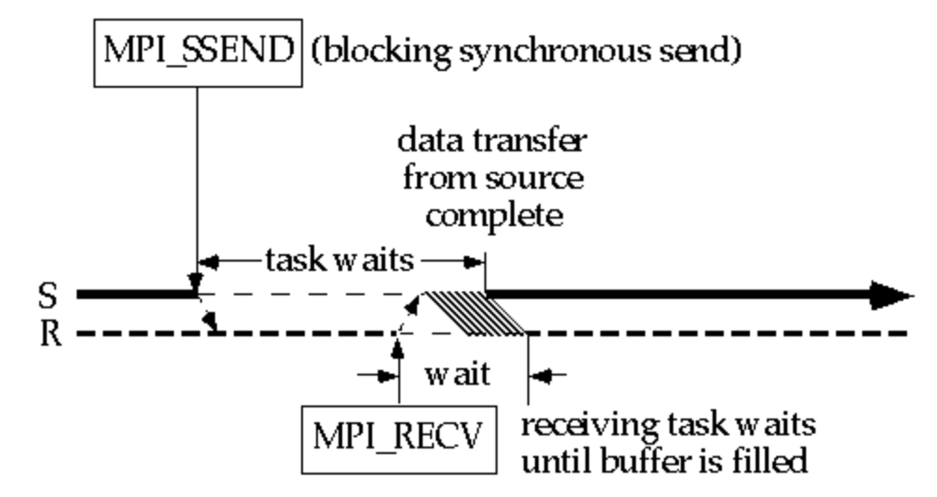
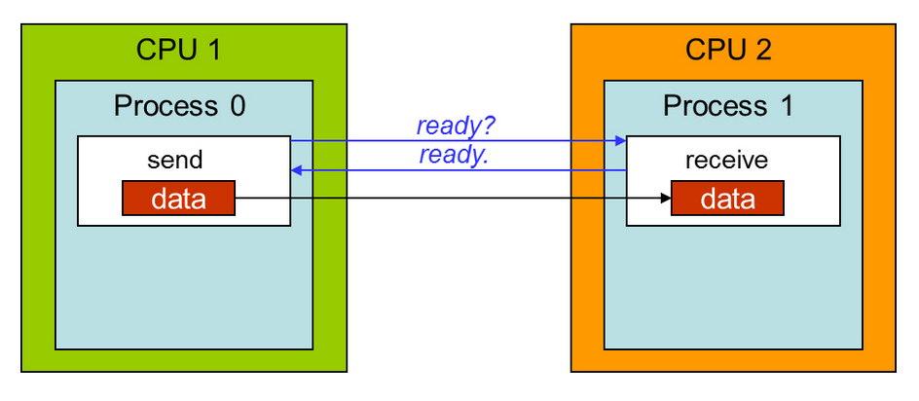
MPI Synchronous Send / Recv (SSend / Recv)
https://cvw.cac.cornell.edu/MPIP2P/

Slide 10
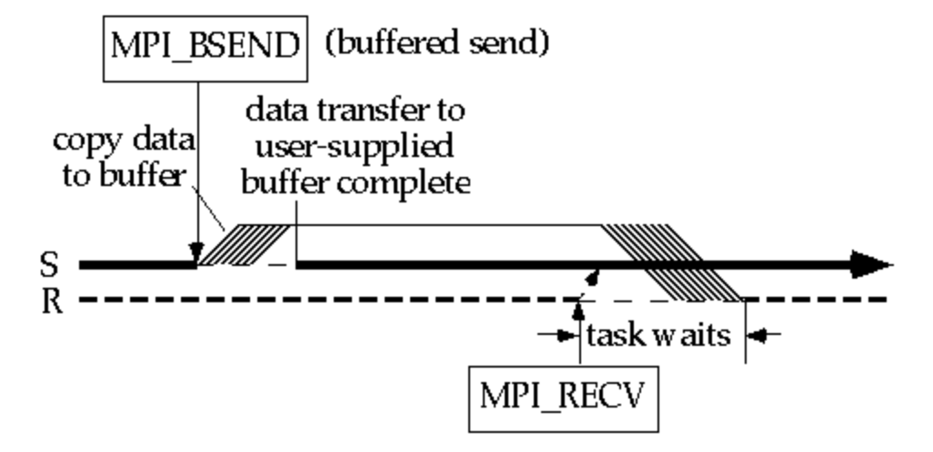
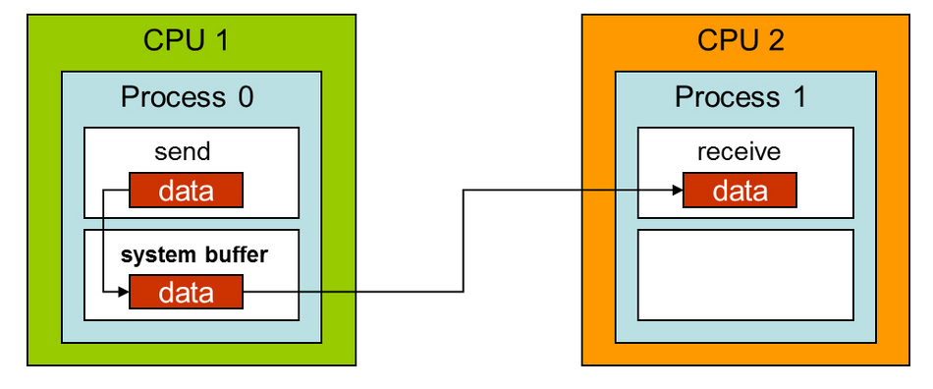
MPI Buffered Send / Recv (BSend / Recv)
Pros:
No handshake – no need to wait for synchronization
You can change your initial buffer
Receiving can be done later
Cons: additional buffer
https://cvw.cac.cornell.edu/MPIP2P/

Slide 11
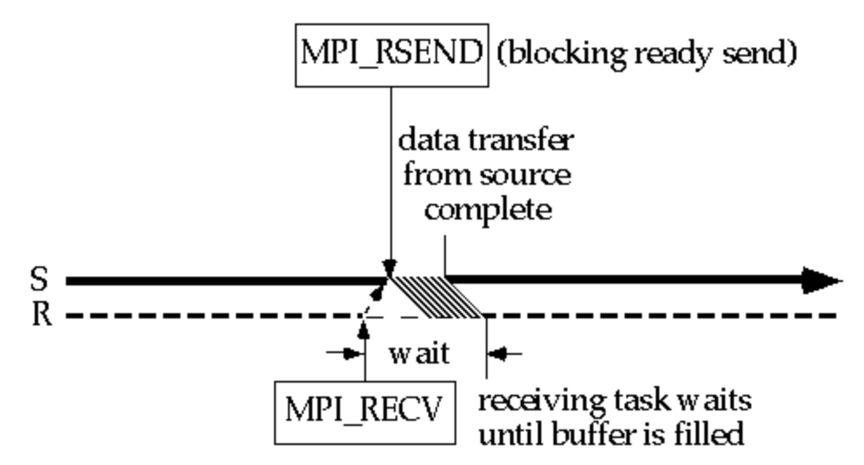
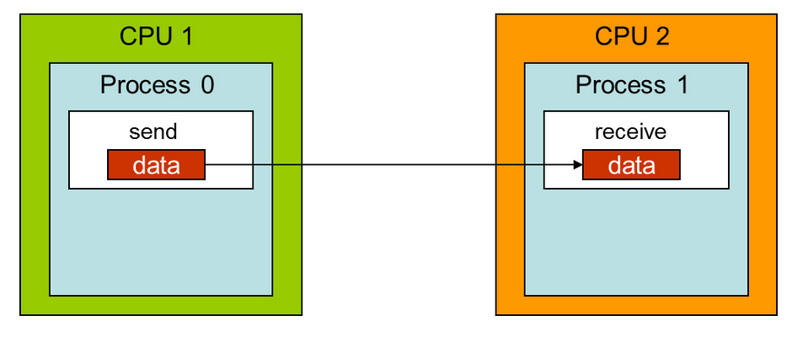
MPI Ready Send / Recv (RSend / Recv)
https://cvw.cac.cornell.edu/MPIP2P/

Slide 12
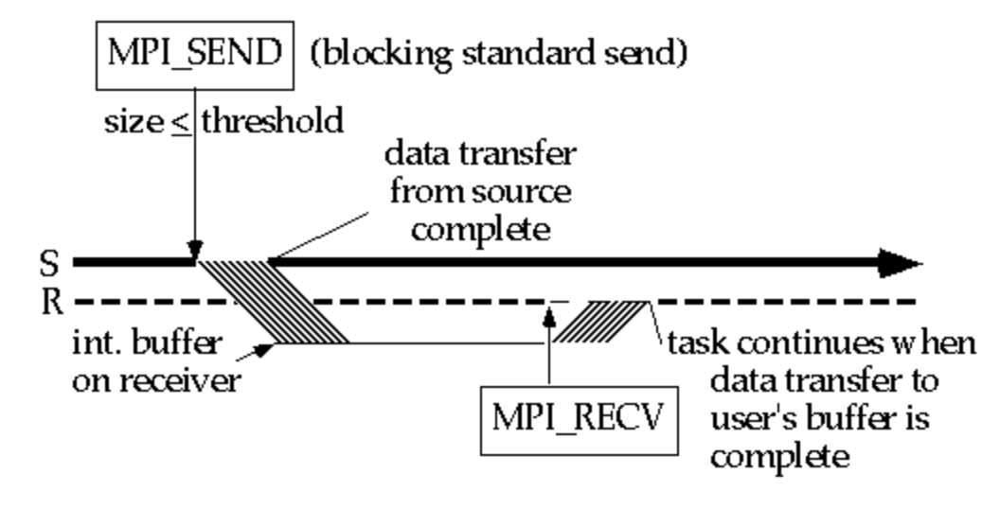
MPI Standard Send / Recv (Send / Recv)
https://cvw.cac.cornell.edu/MPIP2P/

Slide 13
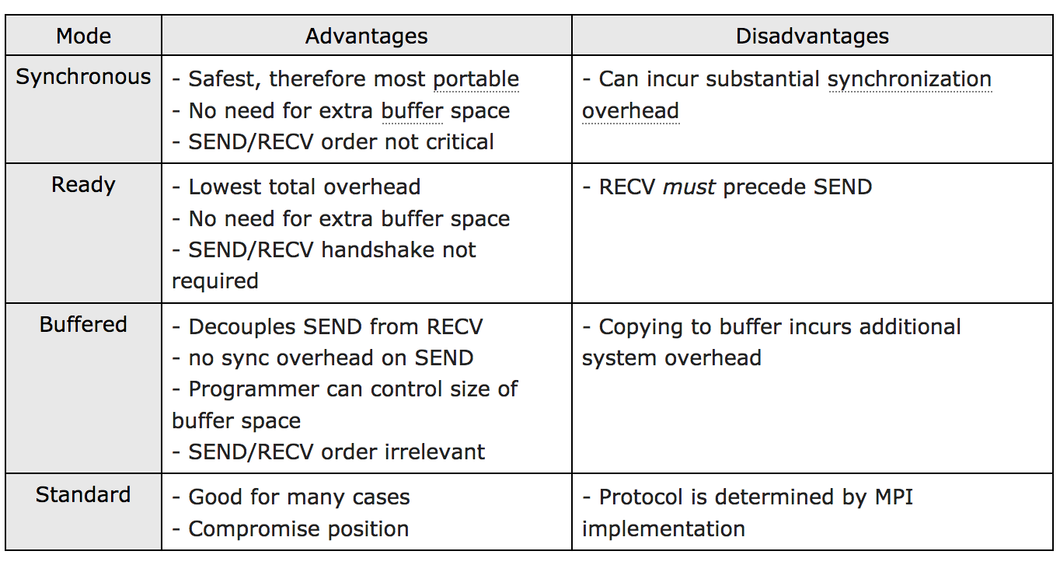
MPI Standard Send / Recv (Send / Recv)
https://cvw.cac.cornell.edu/MPIP2P/

Slide 14

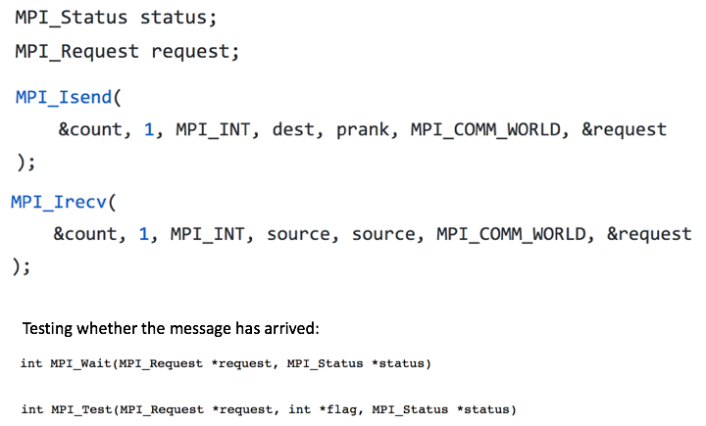
MPI non-blocking P2P communication

Slide 15
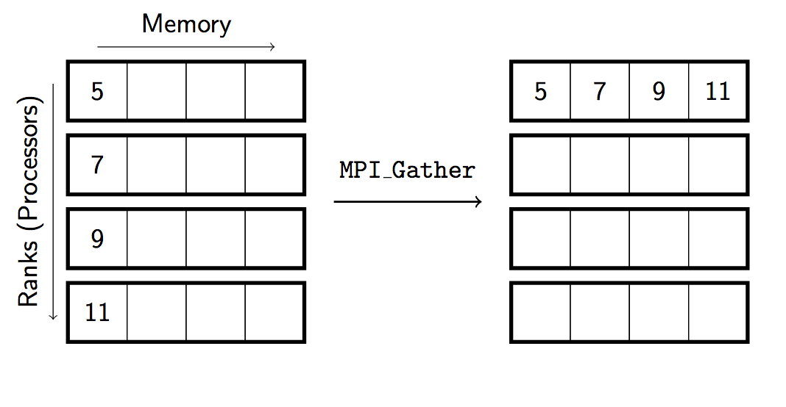
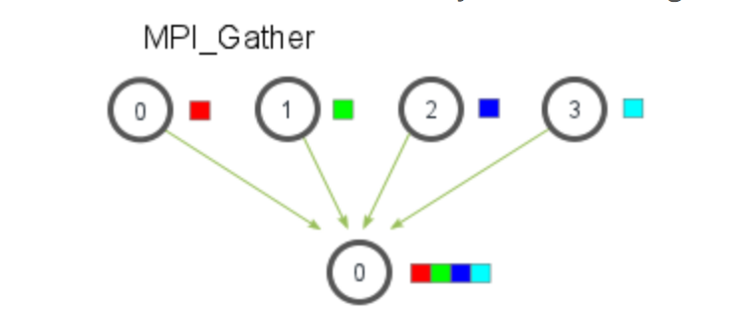
MPI. Collective communications
Gather

Slide 16
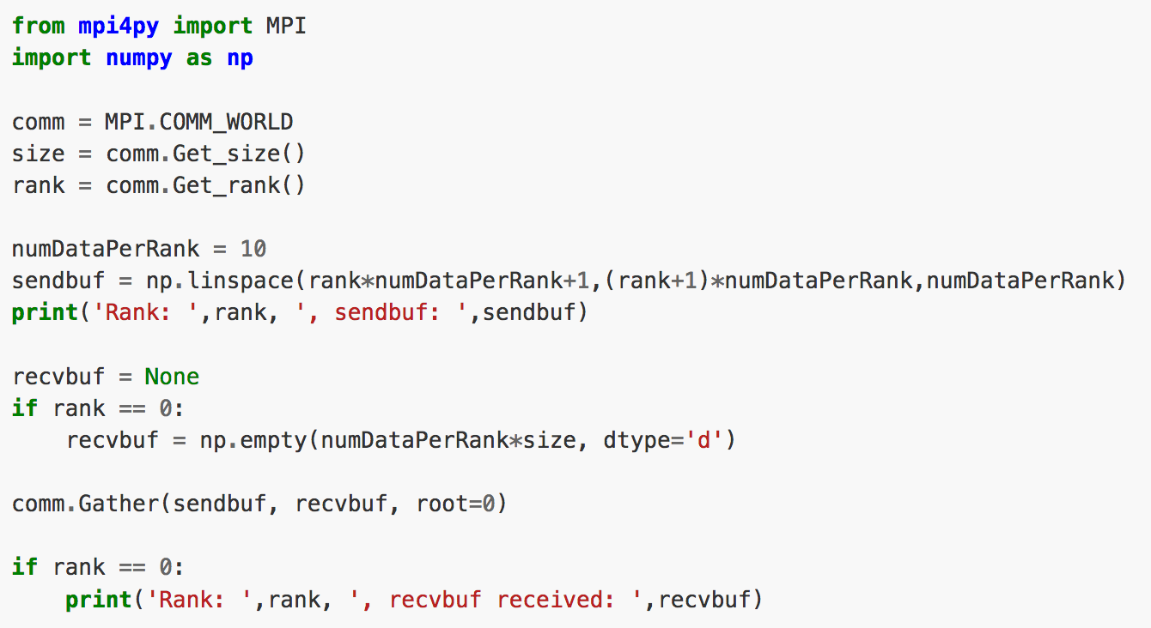
MPI Gather example

Slide 17
Examples and snippets on Canvas/box
Try them out
Understand them
Use them

Slide 18

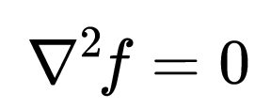
Computation on a mesh (grid)
For example, Laplace eqn:
Or image blurring
Or cellular automata
Each circle is a grid point
The red “plus“ is called a numerical stencil
Need to communicate with neighbours on the grid

Slide 19
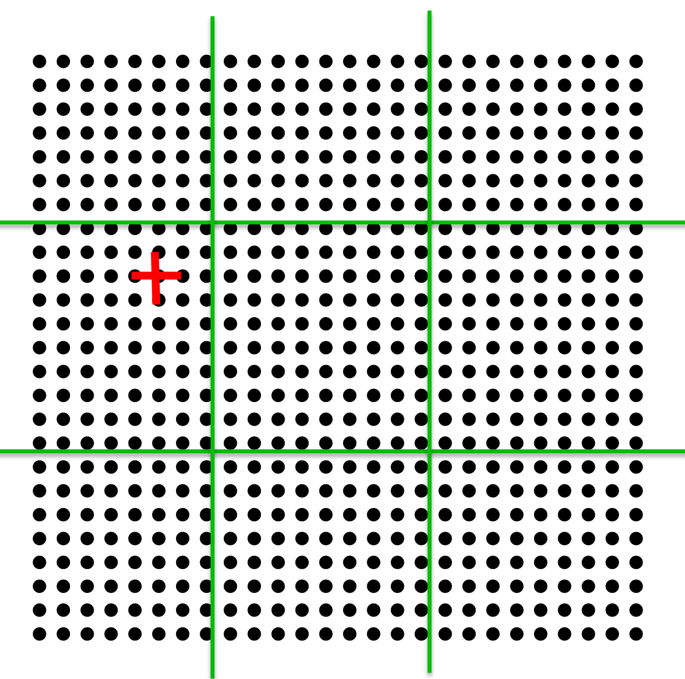
Computation on a mesh (grid)
For example, Laplace eqn:
Or image blurring
Or cellular automata
Each circle is a grid point
The red “plus“ is called a numerical stencil
Need to communicate with neighbours on the grid
Decompose the grid into (equal) chunks, each on a separate processor

Slide 20
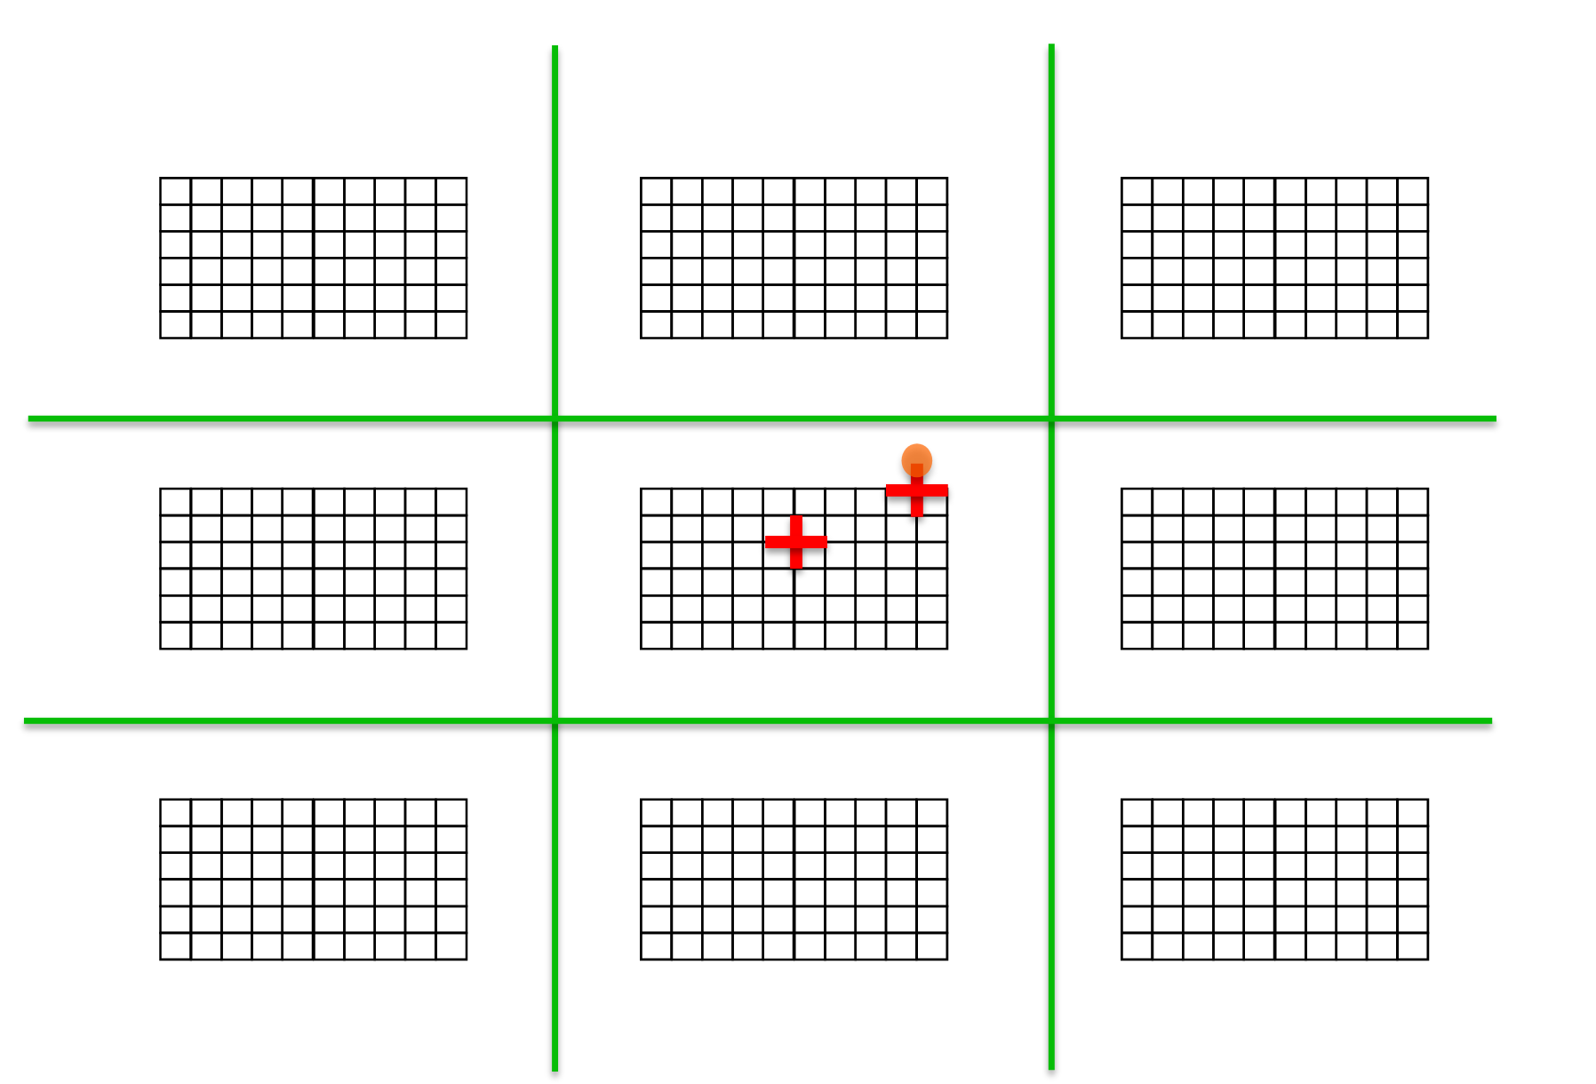
Necessary data transfers

Slide 21
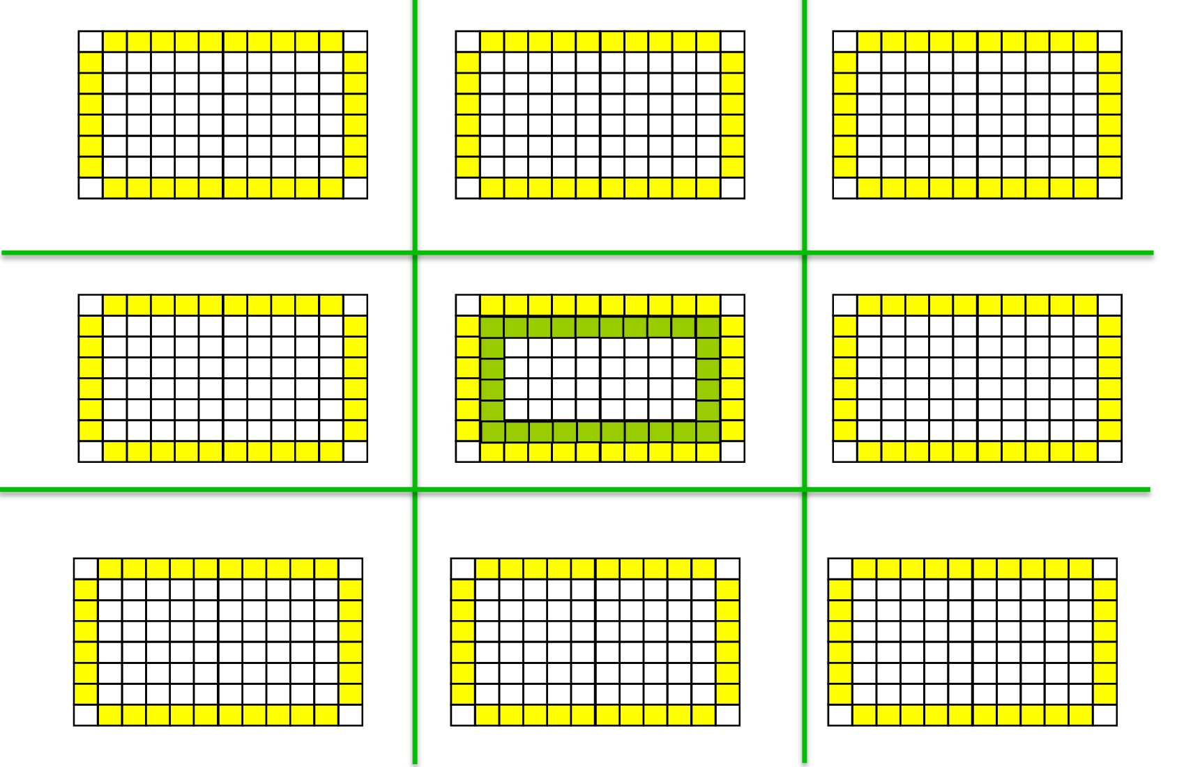
Necessary data transfers
Ghost (halo) cells exchange

Slide 22
Necessary data transfers
Ghost (halo) cells exchange
Ghost cells
Compute area

Slide 23
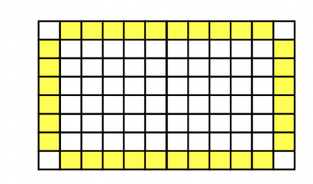
Algorithm
Time (convergence) loop ……
Exchange ghost cells
MPI Send/Recv. Isend, Irecv etc
Perform computation as usual
May use OpenMP, CUDA etc

Slide 24

Example: Game of Life
Any live cell with two or three live neighbors survives.
Any dead cell with three live neighbors becomes a live cell.
All other live cells die in the next generation. Similarly, all other dead cells stay dead.

Slide 25
Game of Life 1: initialization (random)

Slide 26
Game of Life 1: initialization (random)

Slide 27
Initialization in parallel (MPI)
Do not initialize the whole map (grid, mesh) on a single processor and then broadcast to everyone.
Initialize part of the map on every processor

Slide 28
Initialization in parallel (MPI)

Slide 29
Exchange ghosts (MPI)

Slide 30
Exchange ghosts (MPI)

Slide 31
Exchange ghosts (MPI)

Slide 32
Exchange ghosts (MPI)

Slide 33
Do the calculation

Slide 34
Repeat exchange ghosts

Slide 35
How to save the grid
Each processor dumps its own part of the grid to a separate file: “grid-000.dat, grid-001.dat…”
Parallel I/O (for example, HDF5 library)
Do processing of data on the fly (OpenGL, other postprocessing modules)

Slide 43


Flagship supercomputer “Zhores” for AI, Big data and HPC
Hybrid energy-efficient architecture
74 compute nodes
26 nodes with powerful graphic cards Nvidia Tesla V100 (NVLink + RDMA)
tensor cores for deep learning;
90 kWatt power consumption;
1PFlops peak performance;
0.5 Pbytes storage system
#6 in Russia
was installed by our own small team
«Zhores» is a unique for Russia supercomputer capable of solving a wide range of interdisciplinnary problems in machine learning, data science and mathematical modeling in such areas as: biomedicine, image classification, Digital Pharma, Photonics, predictive maintenance, new X- and gamma-ray sources

Slide 44
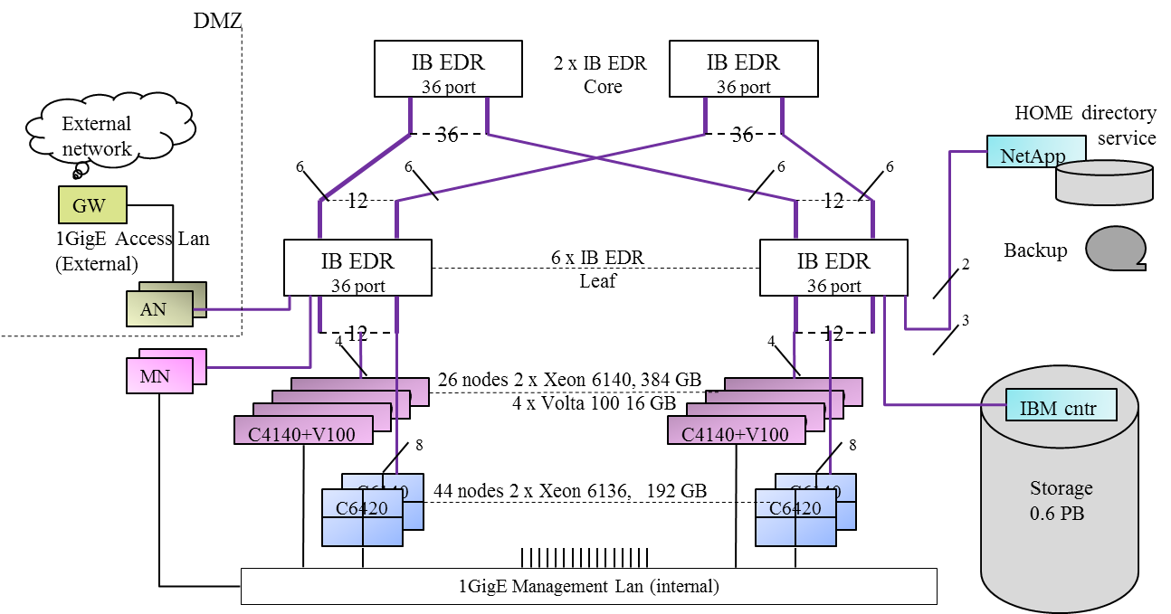
Zhores Cluster Structure

Slide 45
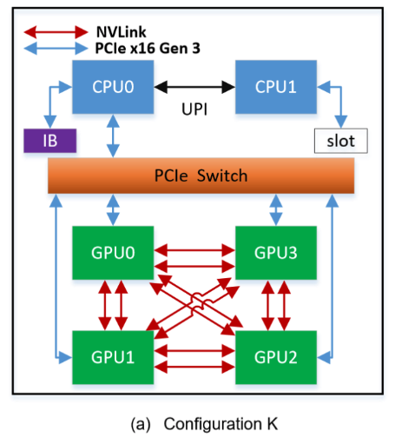
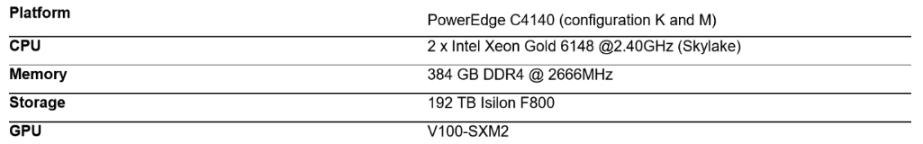
Main power is in the GPU nodes
File system
3-15 GB/s
InfiniBand EDR 100 Gb/s
12.5 GB/s
PCIe 12.5 GB/s
NVLINK 48.3 GB/s
2xCPU Intel 6140 (18c, 2.3 GHz)
GPU
NVidia Tesla V100 SXM2 (16 Gb @ 900 GB/s)

Slide 46
„Zhores“ configuration details
PART | Nodes name # |  | Node characteristics |  |  |  |  |  |  | total
 |  |  | CPU | #cores | F[GHz] | M [GB] | S [GB] | #IB | [TF/s] | #cores | M[GB] | P^{ᵻ}[TF/s]
C6420 | cn | 44 | 6136 | 2 x 12 | 3.0 | 192 | 480 | 1 | 2.3 | 1056 | 8448 | 101.4
C4140 | gn | 26 | 6140 | 2 x 18 | 2.3 | 384 |  | 2 | 2.6 | 936 | 9984 | 68.9
 |  |  | V100 | 4 x 5120 | 1.52 | 4x16 |  | NVL | 31.2 | 532480 | 1664 | 811.2
C6420 | hd | 4 | 6136 | 2 x 12 | 3.0 | 192 | 9 TB | 1 | 2.3 |  | 768 | 9.2
 | an | 2 | 6136 | 2 x 12 | 3.0 | 256 |  | 1 | 2.3 |  | 512 | 4.6
 | vn | 2 | 6134 | 2 x 8 | 3.2 | 384 |  |  | 1.6 |  | 768 | 3.2
 | anlab | 4 | 6134 | 4 x 8 | 3.2 | 192 |  | 1 | 3.3 |  | 768 | 13.1
Totals | 82 |  |  | 2296* |  | 21248 |  |  |  | 2296 | 21248* | 1011.6
 | Notes: Xeon DP Performance per core: F[GHz] x 32 [DP/clock] , i.e. 3.0 x 32 = 96 GF/s , 2.3 x 32 = 73.6 GF/s V100 DP Performance per GPU: 1.53 [GHz] x 1 [DP/clock] x #cores i.e. 1.53x5120 = 7.8 Tflop/s ^{ᵻ} Theoretical performance is calculated using the base (non AVX) frequency for Intel Xeon. *GPU memory and cores are not included in the total

